Slide 1


Supervisor Toolkit:
Initial Conversations
Notes:
TALKING POINTS
What is the benefit of a values-based organization? It gives us a sense of one team, a sense of how to engage and support each other. Importantly, sharing a common purpose gives us a sense of unity.

Slide 2

The Chancellor's Vision
By 2026, the UNT System is one team, values-driven and customer-focused with an emphasis on
excellence, curiosity, and innovation.
Notes:
TALKING POINTS
Read the vision statement on the slide, watch the video, and discuss.
Watch the video together with your team to help establish the framework for the “what and why” of moving us forward. Building trust and moving us forward!

Slide 3
Build a Unified Values-based Culture
Build a true sense of one organization and one team.
Grow as one team: engage, support, and unify our people.
Attract and retain the best faculty, staff, and students.
Sustain a high level of excellence in education, research, philanthropy, and performance.
Always contribute to the communities we serve.
Notes:
TALKING POINTS
As you can see from the video, there are a few objectives we want to achieve together!
Read the objectives from the slide and discuss with your team their thoughts. This is helpful in establishing the “WHY”.
How does this affect US?!
Creating a values-based system will:
Help you understand what is expected of yourself and others in your interactions.
Benefit you with cross-organizational knowledge, expertise and best practices.
Guide your organization to attract, hire, and retain the best people who live our values.
Support us in feeling mutually valued and appreciated.
Create an environment where you enjoy coming to work.

Slide 4
Our “why” behind this values-based culture journey is the:
STUDENT
Notes:
TALKING POINTS
Besides the benefit to us. All of this work has, at its core, the student.
We want students to know they can count on us in every relationship they have with us.
A culture built on values requires continuous discipline. Even if we are happy with the way we are executing the values and behaviors, we must be constantly vigilant and revisit progress on a regular basis. Organizations that succeed with culture change over the long term have a plan for continuous improvement.
To support the individual role every employee plays in creating the type of experiences we want students to have with us, we have defined the shared values and behaviors that will guide us.
Here is where we have traveled on the journey thus far:

Slide 5
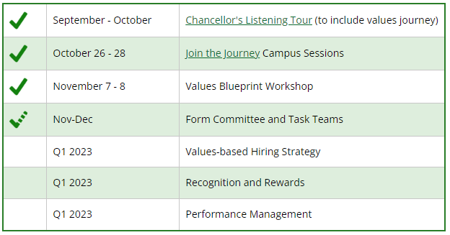
The Journey Thus Far
Notes:
TALKING POINTS
As a supervisor, I want you to know a bit of background regarding the journey thus far. We engaged an outside partner, People Ink, to help guide us. People Ink has a proven record of success in helping companies improve their customer experience by defining and integrating values and behaviors into their business practices and operational systems.
People Ink’s process involved a series of Join the Journey sessions, where everyone across the entire System was encouraged to engage and provide input around the UNT System values. Then, in November, 125 representatives from across the entire UNT System and at various levels of employment, gathered over two days to establish system-wide values.
During the workshop, they worked in groups to make recommendations, democratically agree on the critical few values and their definitions, as well as supporting behaviors and their definitions.
This brought us to a Values Blueprint, which is made up of our values, along with a definition, and the behaviors that support the Values. The Blueprint sets the stage for action by defining minimum behaviors to hire new employees, reward & recognize current employees, and hold people accountable.

Slide 6


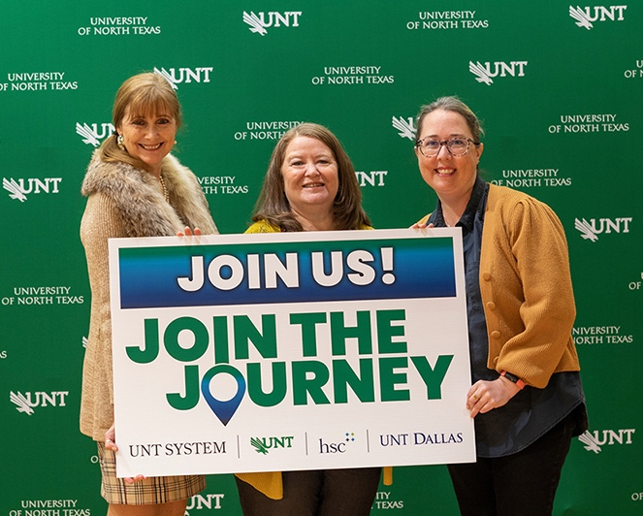
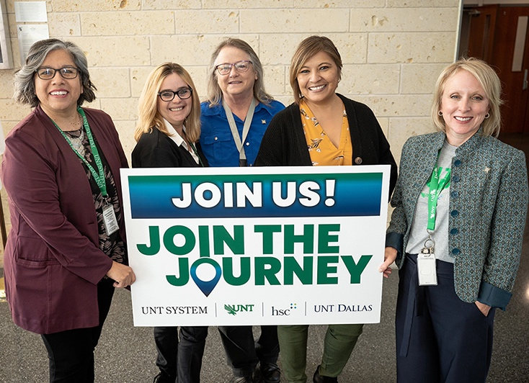

Our Values
Notes:
TALKING POINTS
These are our five values based on the process. Each of us needs to be able to articulate what these mean for our organization, our own business unit and our own specific role.
This journey will evolve. The values for the System will not take away the unique culture of each campus; but rather help to align and unify our values
Say each value.
Now, let’s look at each individual value, its definition and its associated behaviors…

Slide 7
Definition
  Model exceptional standards and act in the best interest of our community.
Behaviors
  Build trust through consistent actions that are honest, transparent, and authentic.
  Provide, accept, and support open and constructive feedback.
  Hold yourself and others accountable for decisions, behaviors, actions, and results.
Notes:
TALKING POINTS
Read and succinctly elaborate, or paraphrase, copy on slide.
For us, here is what this value’s definition and associated behaviors are.
Ask for their thoughts and/or examples of how the team thinks they are living this value currently.

Slide 8
Definition
  Model exceptional standards and act in the best interest of our community.
Team Questions:
  What is the difference between the Golden Rule and the Platinum Rule?
  How have you led with your values?
  What are some ways we can address behaviors that do not reflect our values?
  How can we hold each other accountable?
Notes:
TALKING POINTS
On the slide are potential ways you can engage your team in a conversation about integrating this value and finding meaning within it.
Have a discussion and use this opportunity to have the group learn, develop buy-in, and reflect together.

Slide 9
Definition
  Cultivate opportunities for learning, creating, discovering, and innovating.
Behaviors
  Question the conventional with creative solutions.
  Engage in new experiences for learning and growth.
  Take strategic risk and learn from failure and success.
  Pursue collaborative opportunities.
Notes:
TALKING POINTS
Read and succinctly elaborate, or paraphrase, copy on slide.
For us, here is what this value’s definition and associated behaviors are.
Ask for their thoughts and/or examples of how the team thinks they are living this value currently.

Slide 10
Definition
  Cultivate opportunities for learning, creating, discovering, and innovating.
Team Questions:
  What is meant by strategic risk?
  What experiences can we create that will help us learn
  from each other?
  A solutionary examines the deeper-rooted issues of how to solve a problem. Are you a solutionary and how do you know?
  How does curiosity yield effective problem solving?
Notes:
TALKING POINTS
On the slide are potential ways you can engage your team in a conversation about integrating this value and finding meaning within it.
Have a discussion and use this opportunity to have the group learn, develop buy-in, and reflect together.

Slide 11
Definition
  Champion a people-first approach to building relationships and community.
Behaviors
  Cultivate authentic connections that have a meaningful impact.
  Share expertise and resources.
  Recognize contributions and celebrate success.
  Help at least one person every day.
Notes:
TALKING POINTS
Read and succinctly elaborate, or paraphrase, copy on slide.
For us, here is what this value’s definition and associated behaviors are.
Ask for their thoughts and/or examples of how the team thinks they are living this value currently.

Slide 12
Definition
  Champion a people-first approach to building relationships and community.
Team Questions:
  What are some ways we can invest time to build a people-first approach within our team and meetings?
  Dr. Williams states in the video that we have to…“Give trust to receive trust” …explain what this statement means in building relationships at work.
  How do you like being communicated to? How should we communicate back to each other with respect?
  How can we show our customers/colleagues/team that we care?
Notes:
TALKING POINTS
On the slide are potential ways you can engage your team in a conversation about integrating this value and finding meaning within it.
Have a discussion and use this opportunity to have the group learn, develop buy-in, and reflect together.

Slide 13
Definition
  Foster an inclusive environment of respect, belonging, and access for all.
Behaviors
  Develop awareness and understanding of different experiences.
  Respect diversity of people, beliefs, thoughts, and ideas.
  Support opportunities to remove barriers to equity and inclusion.
Notes:
TALKING POINTS
Read and succinctly elaborate, or paraphrase, copy on slide.
For us, here is what this value’s definition and associated behaviors are.
Ask for their thoughts and/or examples of how the team thinks they are living this value currently.

Slide 14
Definition
  Foster an inclusive environment of respect, belonging, and access for all.
Team Questions:
  How can we move from “me” to “we” or “them” to “us”? (thinking about mental or structured silos)
  What are the benefits or advantages in greater diversity, equity, and inclusion in the workplace?
  What components of the “Better Together” value aligns with our personal values? In what ways can we consistently demonstrate this value while embracing diverse perspectives?
Notes:
TALKING POINTS
On the slide are potential ways you can engage your team in a conversation about integrating this value and finding meaning within it.
Have a discussion and use this opportunity to have the group learn, develop buy-in, and reflect together.

Slide 15
Definition
  Exhibit passion and pride in the experiences we create.
Behaviors
  Go beyond the ordinary and surpass expectations.
  Be prepared, be present, and actively participate.
  Promote enthusiastic engagement.
  Cultivate a positive environment and find opportunities for fun and recognition.
Notes:
TALKING POINTS
Read and succinctly elaborate, or paraphrase, copy on slide.
For us, here is what this value’s definition and associated behaviors are.
Ask for their thoughts and/or examples of how the team thinks they are living this value currently.

Slide 16
Definition
  Exhibit passion and pride in the experiences we create.
Team Questions:
  How can we convert a values culture into action? What type of energy do we want to produce?
  What does it mean for us to play “in the big leagues” as the Chancellor mentioned?
  How can understanding your own values better engage, support, and unify our team?
  Demonstrating passion looks different for different people, what does “Show your Fire” look like for an introverted team player?
Notes:
TALKING POINTS
On the slide are potential ways you can engage your team in a conversation about integrating this value and finding meaning within it.
Have a discussion and use this opportunity to have the group learn, develop buy-in, and reflect together.

Slide 17
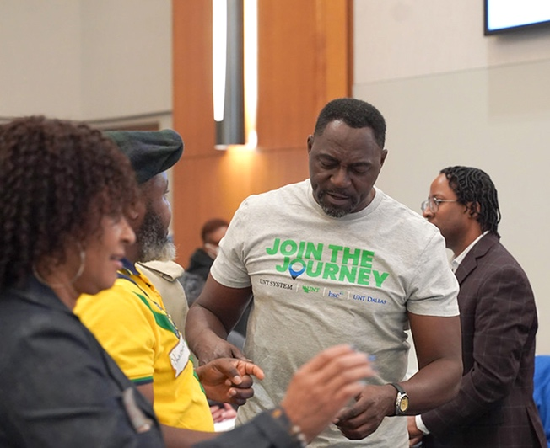
Next Steps
Start living the values today!
  Understand, internalize, and articulate the shared values and behaviors:
  Sustain the momentum by demonstrating the shared values and behaviors in your actions
  Make the shared values meaningful within our work groups
  Share successes among our teams and peers
  Make the commitment to live the values everyday and hold ourselves and others accountable
Notes:
TALKING POINTS
We know that values can’t just be words; they have to be reflected in everything you do. We’re looking at how we integrate the shared values into our hiring practices, the ways we measure and reward performance, and the ways we recognize our people. We want to make sure that the practices we use to guide performance are in sync and aligned with these core values.
Explain there will be committees the team can join to help us as a group to decide how hiring, accountability, and recognition will work within our new set of values. There is much more exciting things to come!
You can also:
Follow the Join the Journey webpage.
Express interest to your supervisor and values@untsystem.edu in serving on a team
Participate in the Values Pledge - Become a Values Ambassador
Attend the Values Rollout events
Join Enterprise Committees
Cross-enterprise representation
Integrate values into processes
Communication
Hiring
Recognition
Accountability
Establish uniformity and consistency
Join Campus Committees
Linkage to enterprise committees
Implement System-wide values and processes at campus
Values Champions
Promote inclusion and engagement
Create values awareness
Celebrate values
Recognize people living our values
Listen, Learn & Give Feedback
Attend learning sessions
Contribute to Join the Journey sessions
Respond to Polls
Submit ideas and feedback
Most importantly, we continue as a team to LIVE the values (use examples from the slide and/or discuss.)

Slide 18
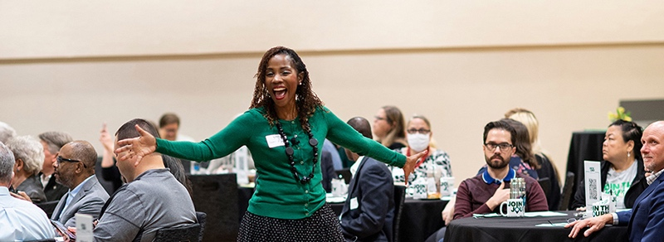
ADDITIONAL RESOURCES
Notes:
Review and Discuss the Values Action Plan Worksheet

Slide 19
Exercise 1 - Living Our Values Worksheet
Team: _____________________ Team Leader: ___________________ Date: ____________
Instructions: With your team, develop examples of what it looks like in your department to “live” the Values and Behaviors.
Value/Behavior | Examples – what it looks like in our department
 | What results if Good implementation? Desired Outcomes? | What results if Poor implementation? Negative Consequences?
Courageous Integrity: Model exceptional standards and act in the best interests of our campus communities.
Be Curious: Cultivate opportunities for learning, creating, discovery, and innovation.
We Care: Champion a people-first approach to building relationships and community.
Better Together: Foster an inclusive environment of respect, belonging, and access for all.
Show Your Fire: Exhibit passion and pride in the experiences we create.
Notes:
TALKING POINTS
Read and succinctly elaborate, or paraphrase, copy on slide.
For us, here is what this value’s definition and associated behaviors are.
Ask for their thoughts and/or examples of how the team thinks they are living this value currently.

Slide 20
Exercise 2 – Values Action Plan Worksheet
Instructions: With your team, after discussing the “Living Your Values Worksheet, develop an action plan for Values & Behaviors within your team culture and workforce. Include how you will continue to develop examples and stories that exemplify “Living” the Values/Behaviors on an ongoing basis.
Action Item | Target Date | Assigned | Resources/Notes
1. Set a date for your team Values discussion.
2. Contact a Values Committee member to help facilitate Team discussion.
3. Conduct Team discussion and deliberation about “Living Our Values.”
4. Select a value(s) that you want to develop goals for your team around.
5. Next steps to continue discussing and reinforcing the Values/Behaviors with your team.
6. Create 2023 Action Plan with benchmark dates and behaviors that would indicate successful team implementation.
Notes:
TALKING POINTS
Read and succinctly elaborate, or paraphrase, copy on slide.
For us, here is what this value’s definition and associated behaviors are.
Ask for their thoughts and/or examples of how the team thinks they are living this value currently.

Slide 21
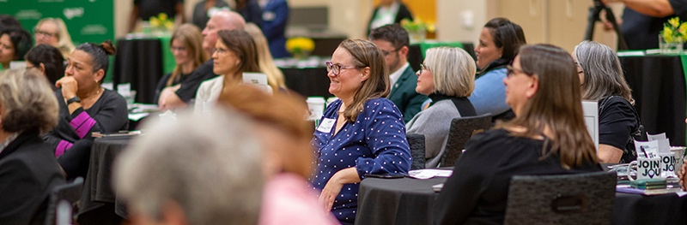
Contacts
Questions, Concerns, & Recommendations
Join the Journey Feedback Form
Email: values@untsystem.edu
Website: https://www.untsystem.edu/about-us/values/
Notes:
TALKING POINTS
Read and succinctly elaborate, or paraphrase, copy on slide.
For us, here is what this value’s definition and associated behaviors are.
Ask for their thoughts and/or examples of how the team thinks they are living this value currently.

